Slide 1

Health Insurance
Provider Database
By,
Lakshmi Durga Panguluri
Ananya Chowdhury
Amrita Prabhu

Slide 2
Introduction
Health Insurance providers provide Insurance plans to the Subscribers.
Subscribers takes services from the Hospitals and accordingly bill is generated.
Subscribers claims from Insurance providers their money based on the plans they are subscribed to.
The Insurance provider pays coverage amount based on their individual plans.

Slide 3
Objective
Health insurance is a type of insurance that pays for medical expenses in exchange for premiums. The monthly or annual premium is paid and the insurance policy contracts healthcare providers and hospitals to provide benefits to its members at a discounted rate.
Health Insurance providers maintain a database for the large data they handle of their Subscribers.
It is also essential to maintain details of the plans that the Subscribers are Subscribed to.

Slide 4
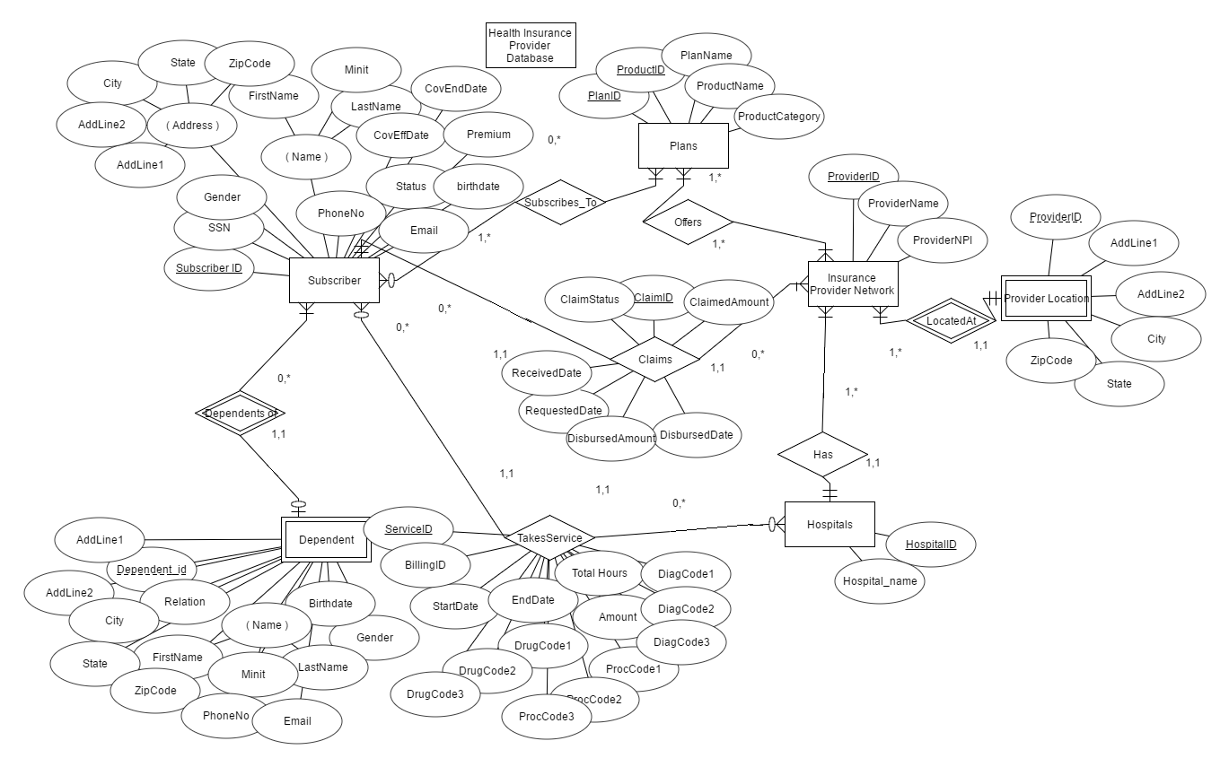
ER Diagram:

Slide 5
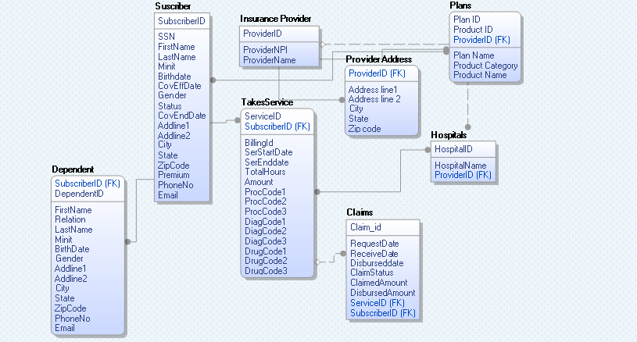
ER Model:

Slide 6
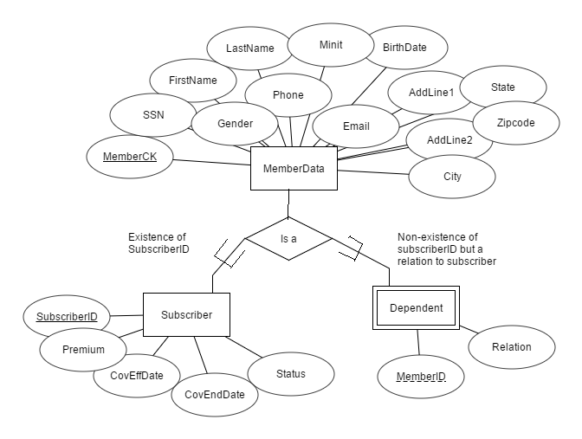
EER Diagram

Slide 7
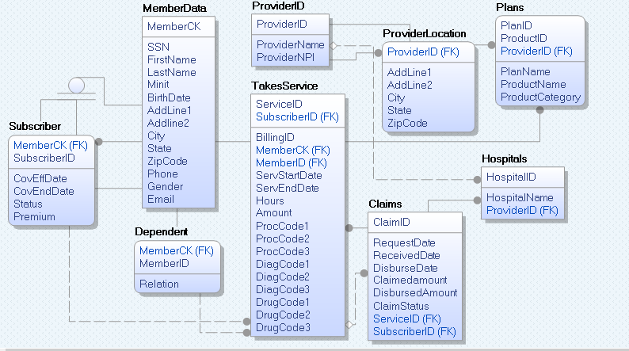
Data Model- Logical layer

Slide 8
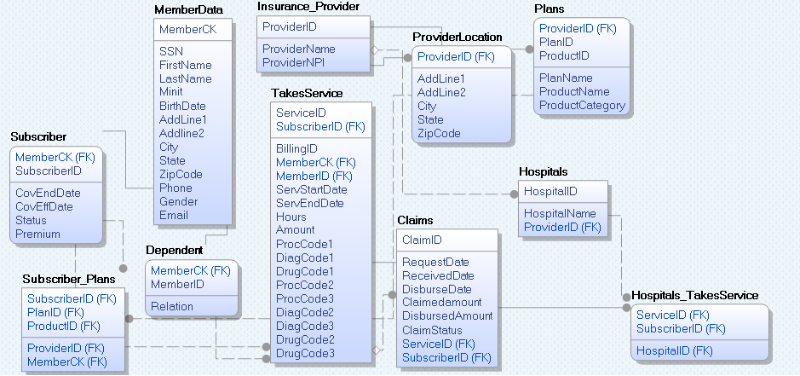
Data Model- Physical layer:

Slide 9



SQL Implementation

Slide 10
Validation
1. Find the name of the Subscriber who has a son as dependent.
SELECT m.FirstName, m.LastName, m.Minit from MemberData m, Dependent d, subscriber s where m.MemberCK=s.MemberCK and s.SubscriberID=d.MemberID and d.Relation='Son';
2. Find the Address, City, State, ZipCode of the insurance provider 'Blue Cross and Blue Shield of NewYork'.
SELECT AddLine1, AddLine2, City, State, ZipCode from ProviderLocation p, InsuranceProvider i where p.ProviderID=i.ProviderID and i.ProviderName='Blue Cross and Blue Shield of NewYork';
3. Find the total amount Claimed by the SubscriberID '1000000005'.
SELECT Sum(ClaimedAmount) AS Total_amountClaimed FROM Claims where SubscriberID='1000000005';
4. What are the Plan names provided by the ProviderID 'PRV00001'.
SELECT p.PlanName from Plans p, InsuranceProvider i where i.ProviderID=p.ProviderID and i.ProviderID='PRV00001';
5. Find the premium of the Subscribers whose first name is 'DANIEL'
Select s.SubscriberID, s.Premium from subscriber s, memberdata m where s.memberCK=m.memberCK and m.Firstname='Daniel';

Slide 11
6. Find the premium of the Subscribers whose first name is 'DANIEL'
Select s.SubscriberID, s.Premium from subscriber s, memberdata m where s.memberCK=m.memberCK and m.Firstname='Daniel';
7. Find the number of Subscribers who took services where the provider is located in Texas.
SELECT count(SubscriberID) AS No_of_Subscriber FROM TakesService WHERE HospitalID in (select HospitalID from Hospitals where ProviderID in (select ProviderID from ProviderLocation where State='TX'));
8. Write a query to display Premium and claimedamount of the subscriber whose claimstatus is paid and birsbursedamount is in between 5000 and 7000.
select S.Premium, c.Claimedamount from Subscriber s Inner Join claims c on s.SubscriberID=c.SubscriberID where c.ClaimStatus='Paid' and c.disbursedamount between 5000 and 7000;
9. Find all the Provider names and their Address, City and State.
SELECT p.ProviderName, i.AddLine1, i.AddLine2, i.City, i.State from InsuranceProvider p LEFT JOIN ProviderLocation i on p.ProviderID=i.ProviderID;
10. Find all the Member names and the serviceID taken or may not taken by them.
select m.FirstName, m.LastName, s.ServiceID from MemberData m LEFT JOIN TakesService s on m.MemberCK=s.MemberCK GROUP BY m.FirstName, m.LastName, s.ServiceID, m.MemberCK;

Slide 12
Conclusion
The data model created helps the Insurance Provider maintain the database.
The ER diagram, EER diagram with the specialization and generalization, Data Model shows the relationships in the database.
Database is created referring to the relationships. The simple and the complex queries validates the database created.

Slide 13
Thank You!
Thank You

